Slide 1
System and Network aspect: basic
Nessus scan met/zonder firewall
Vulnerabilities:
MS08-067: Microsoft Windows Server Service Crafted RPC Request
MS09-001: Microsoft Windows SMB Vulnerabilities Remote Code Execution
MS17-010: Security Update for Microsoft Windows SMB Server
MS06-035: Vulnerability in Server Service Could Allow Remote Code Execution

Slide 2
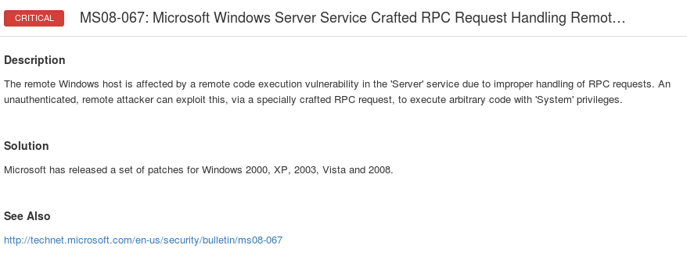
System and Network aspect: basic
Oplossen van deze vulnerabilities:

Slide 3
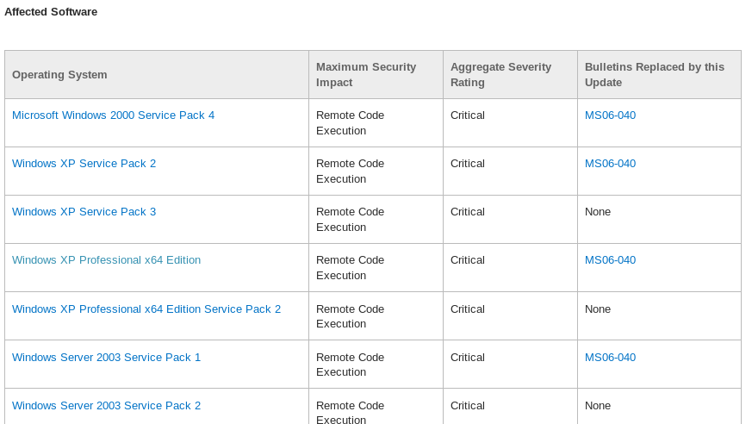
System and Network aspect: basic

Slide 4
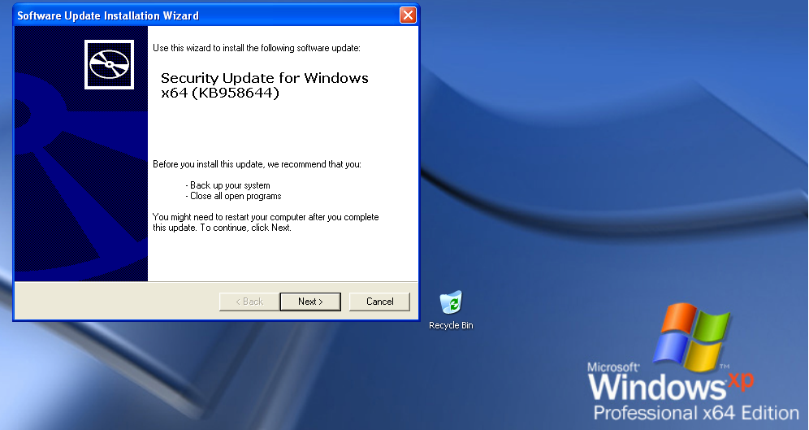
System and Network aspect: basic

Slide 5
System and Network aspect: basic
Nessus scan van Metasploit
Drie vulnerabilities
Debian OpenSSH/OpenSSL Package Random Number Generator Weakness
rexecd Service Detection
Unix Operating System Unsupported Version Detection

Slide 6
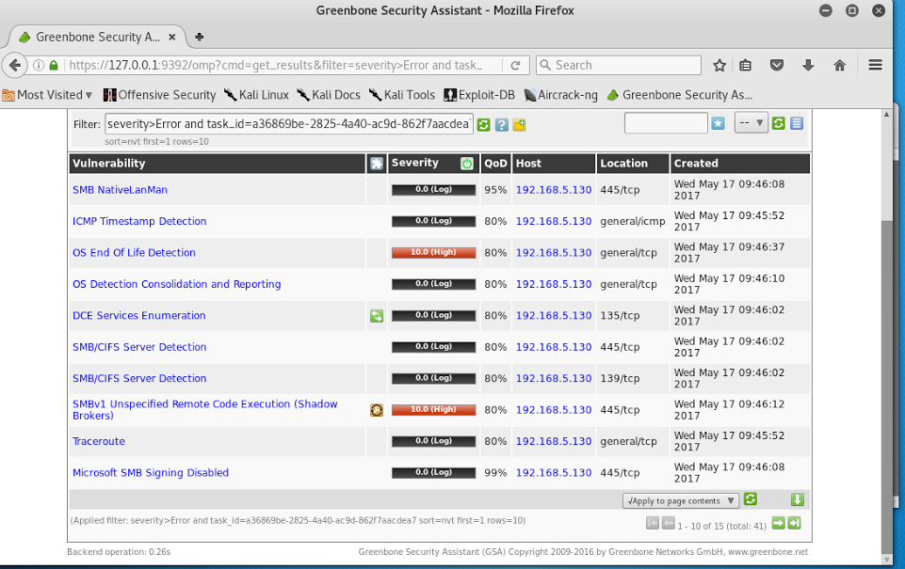
System and Network aspect: Minimal
Openvas

Slide 7
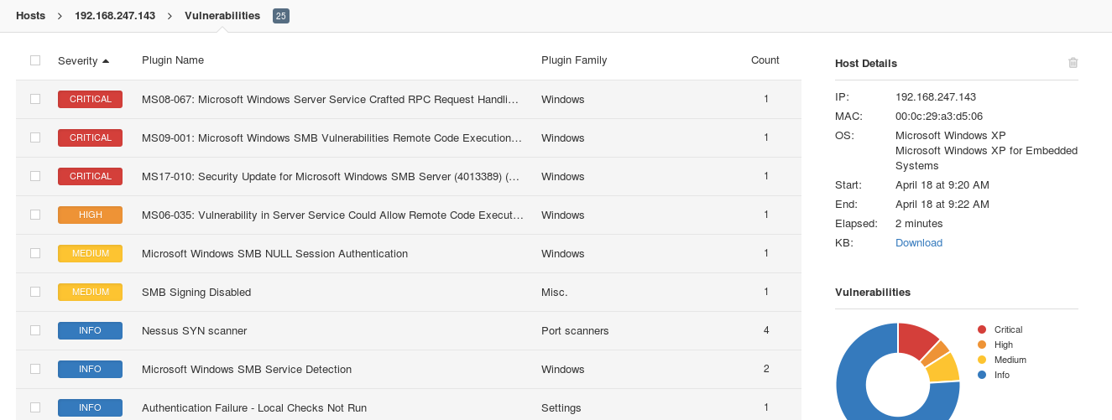
System and Network aspect: Minimal
Nessus

Slide 8
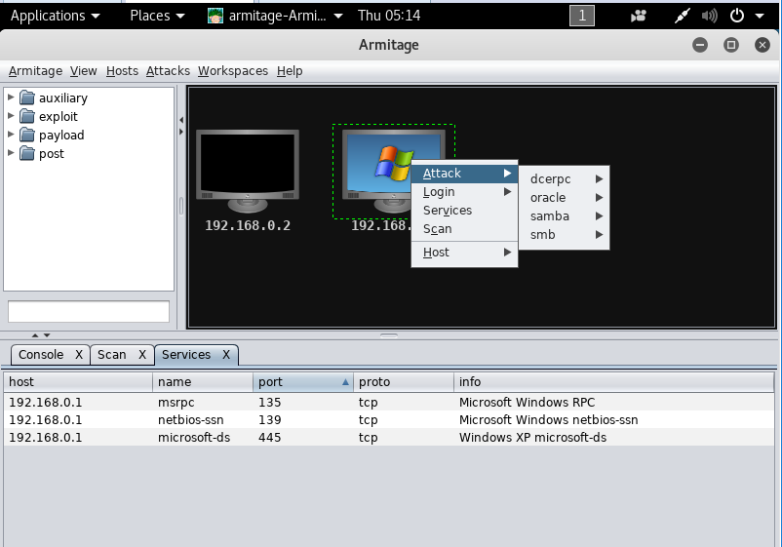
System and Network aspect: Minimal
Armitage

